Slide 1
Digital Portfolio
STUDENT NAME:
REGISTER NO AND NMID:
DEPARTMENT:
COLLEGE: COLLEGE/ UNIVERSITY

Slide 2
PROJECT TITLE
DOCTOR

Slide 3


AGENDA
Problem Statement
Project Overview
End Users
Tools and Technologies
Portfolio design and Layout
Features and Functionality
Results and Screenshots
Conclusion
Github Link
3/21/2024 Annual Review

Slide 4

PROBLEM STATEMENT
Build a simple, responsive Doctor Portfolio web page that includes the doctor's name, profile image, specialization, about section, contact form, and interactive features (e.g., a greeting based on time of day).

Slide 5

PROJECT OVERVIEW
To design and build a simple, responsive, and professional portfolio website for a doctor using basic HTML, CSS, and JavaScript. The site will showcase the doctor's profile, services, qualifications, contact form, and working hours.

Slide 6

WHO ARE THE END USERS?
End users are the people who will use or interact with the website. For a doctor’s portfolio, typical end users are: Patients – looking for information about the doctor (qualifications, specialties, clinic location, appointment booking). Medical institutions – verifying credentials for collaboration. Recruiters – searching for qualified professionals. Peers – other doctors or researchers viewing published work or collaboration interests. General Public – researching health services.

Slide 7

TOOLS AND TECHNIQUES
HTML - Structure of the webpage CSS- Styling the page (colors, layout, fonts) JavaScript- Interactivity (like form validation, button actions)

Slide 8
POTFOLIO DESIGN AND LAYOUT
Header – Name, title, and navigation links. About Me – Brief bio and photo. Specialties / Services – List of services with icons. Contact – Contact form with phone/email. Footer – Copyright and social media.
8

Slide 9
FEATURES AND FUNCTIONALITY
Doctor's profile (name, specialty, photo) About section Specializations Experience timeline Contact form Appointment form with basic validation using JavaScript Responsive design

Slide 10
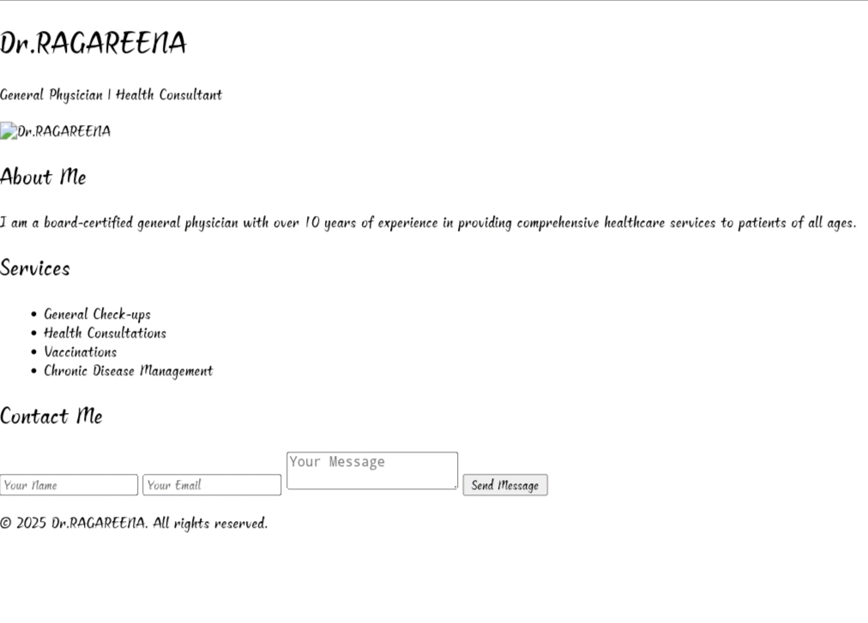

RESULTS AND SCREENSHOTS
3/21/2024 Annual Review
10

Slide 11
CONCLUSION
This simple doctor portfolio website provides a clean and responsive interface for showcasing a medical professional's profile, services, and contact options. Using HTML for structure, CSS for styling, and JavaScript for interactivity, it serves as a professional online presence. This template can easily be expanded with more features such as online booking, a blog, or patient testimonials.
11

